Slide 1

Linear-Exponential Algorithm-based Open Source Dive Computer
Sebastian Thomas
Bachelor Thesis
Supervisor: Tommaso Polonelli
Professor: Prof. Luca Benini
16. June 2026

Slide 2
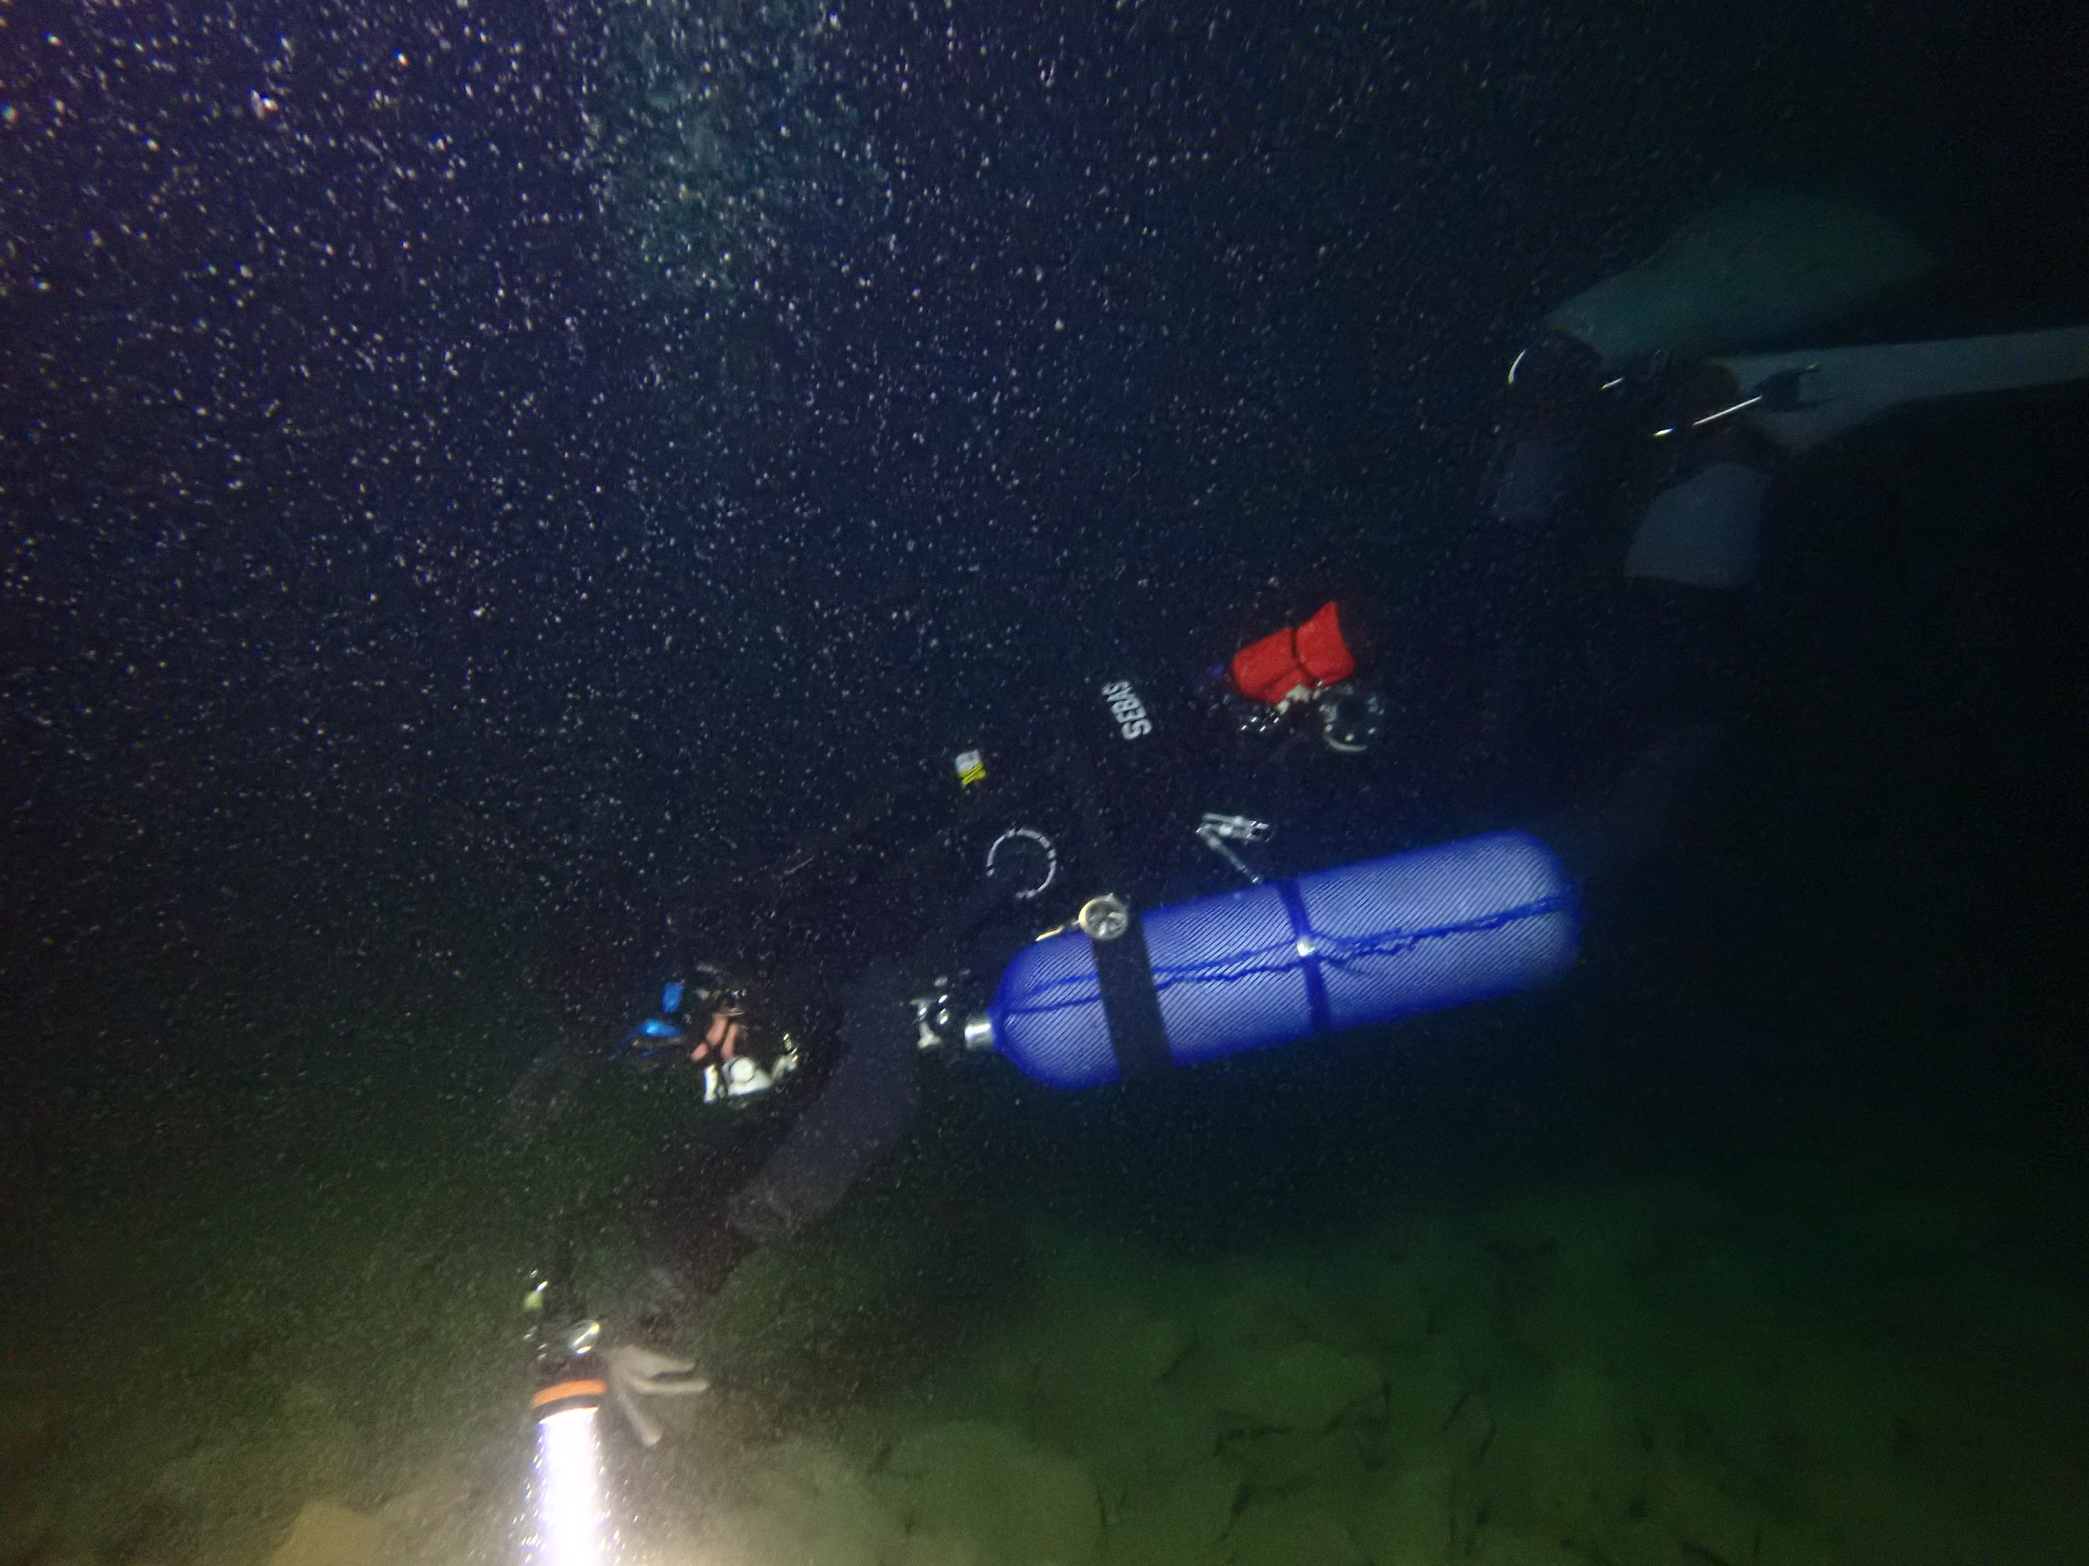
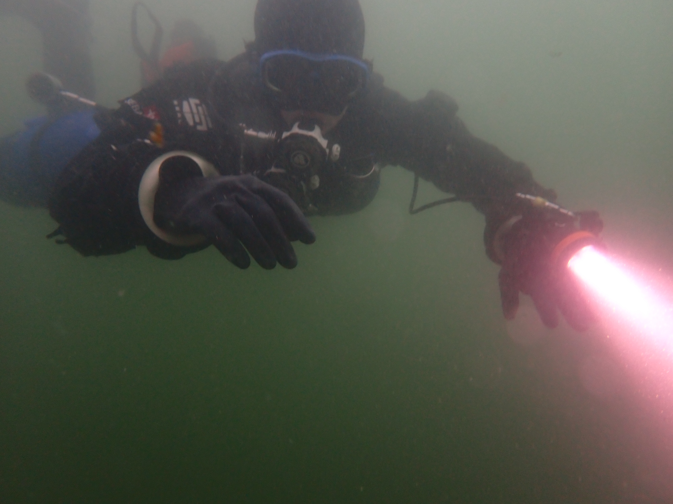
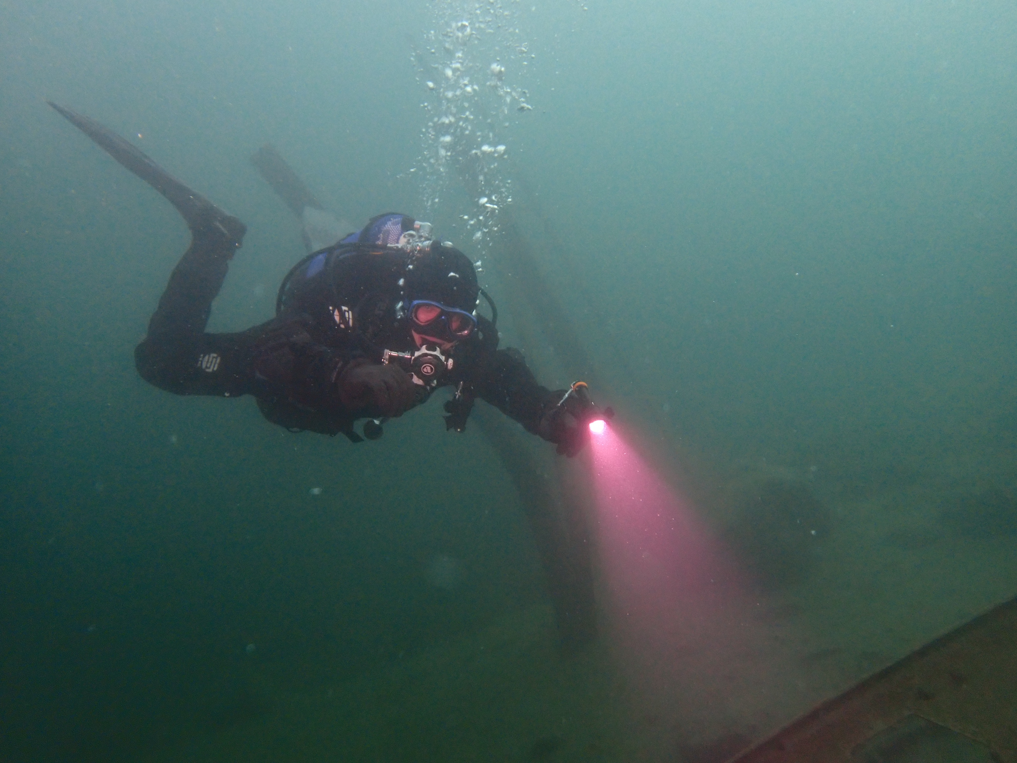
Introduction: Diving & Hyperbaric Environments

Slide 3
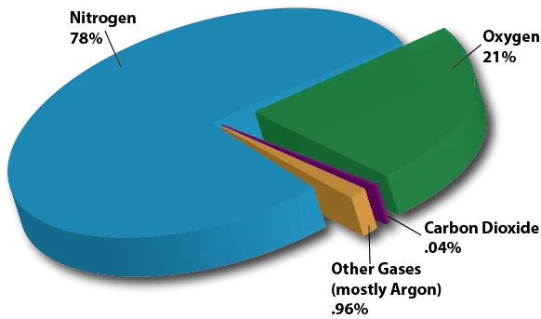
Introduction: Diving & Hyperbaric Environments
0. Composition of Air
0. https://scied.ucar.edu/learning-zone/air-quality/whats-in-the-air
Notes:
Larger image

Slide 4
Introduction: Dive Computers
Hyperbaric Inert Gas
Hyperbaric O₂
Bookkeeping
Decompression
O₂ Toxicity
Dive Log
0. Composition of Air
0. https://scied.ucar.edu/learning-zone/air-quality/whats-in-the-air
Notes:
N2 & He = Inert
Hyperbaric Medicine: “bucket chemistry”
running calculations at fixed-rate not required
Variable-rate algorithms researched, but not in dive computers
Limit Customizability, transparency
Smart research ideas -> benefit other works

Slide 5
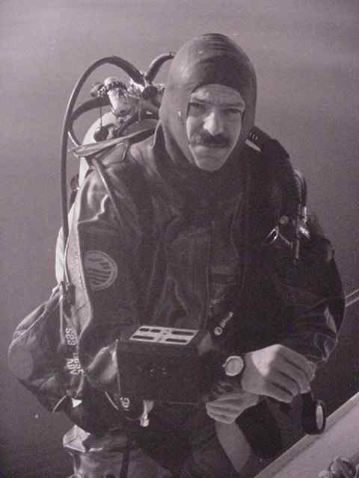
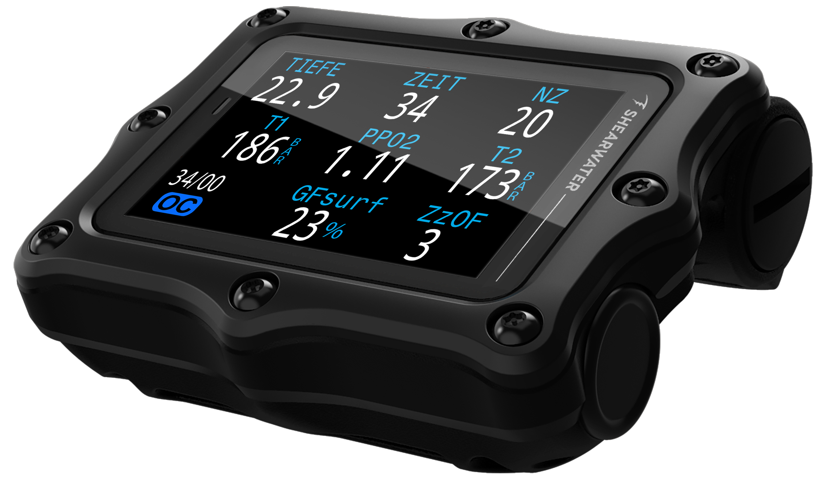
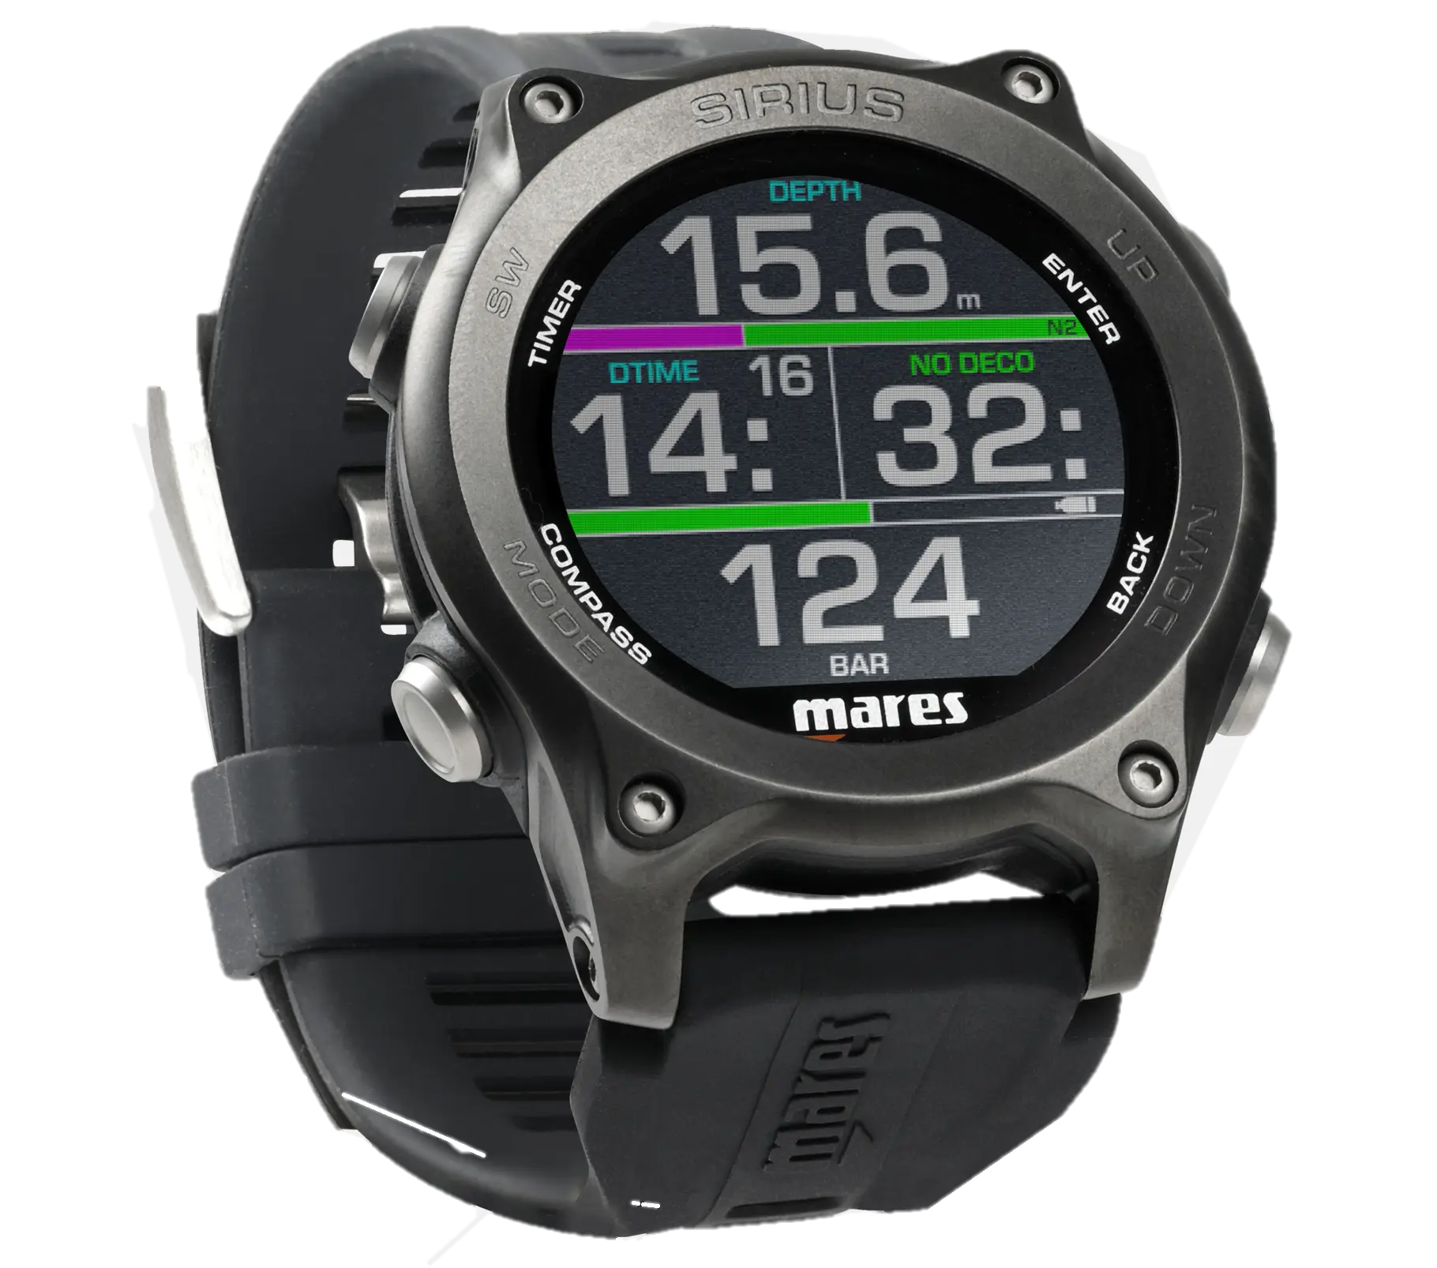
Introduction: Dive Computers
Hyperbaric Inert Gas
Hyperbaric O₂
Bookkeeping
Decompression
O₂ Toxicity
Dive Log
1. Hans Hass DECO-BRAIN ® (1980s)
3. Shearwater Perdix 3 (2026)
2. Mares Sirius (2023)
1. https://www.divetable.info/img/helmet3.jpg
2. https://cdn-mdb.head.com/CDN3/D/414145_BKBK/1/1820x2428/sirius-black.webp
3. https://cdn.shopify.com/s/files/1/0711/0538/0397/files/ly_13501-01_perdix_3_black_left_angle_tec_bar_depth_22_9_1_german_1778708275.png
Notes:
Hyperbaric Medicine: “bucket chemistry”
running calculations at fixed-rate not required
Variable-rate algorithms researched, but not in dive computers
Limit Customizability, transparency
Smart research ideas -> benefit other works

Slide 6
Problem Description
Commercial setting
Fixed decompression algorithms
Fixed log rate
Notes:
Fixed decompression algorithm: Why other algorithm?→ Hypothesis: Do better than commercial results
Fixed log rate: Why other rate? → Hypothesis: Less space

Slide 7
Thesis Goals
Design & Build Compact PCB
Implement & Profile Linear-exponential deco-algorithm
Implement & Profile Variable-rate algorithms
Notes:
-> Release as Open Source project + in Rust for (Memory) Safety
Decompression models
O2 Toxicity Calculations
Dive Log to Flash

Slide 8
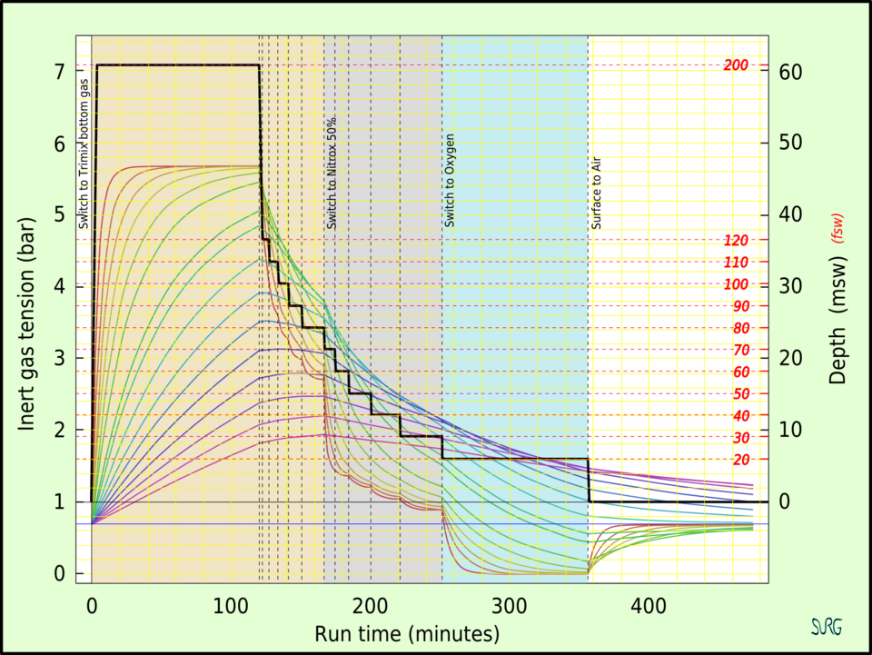
Background: Decompression Algorithms
5. Example Decompression Model
5. https://en.wikipedia.org/wiki/File:Inert_gas_tensions_in_the_tissue_compartments_during_a_decompression_dive.png
Notes:
Explain plot better, including axes

Slide 9
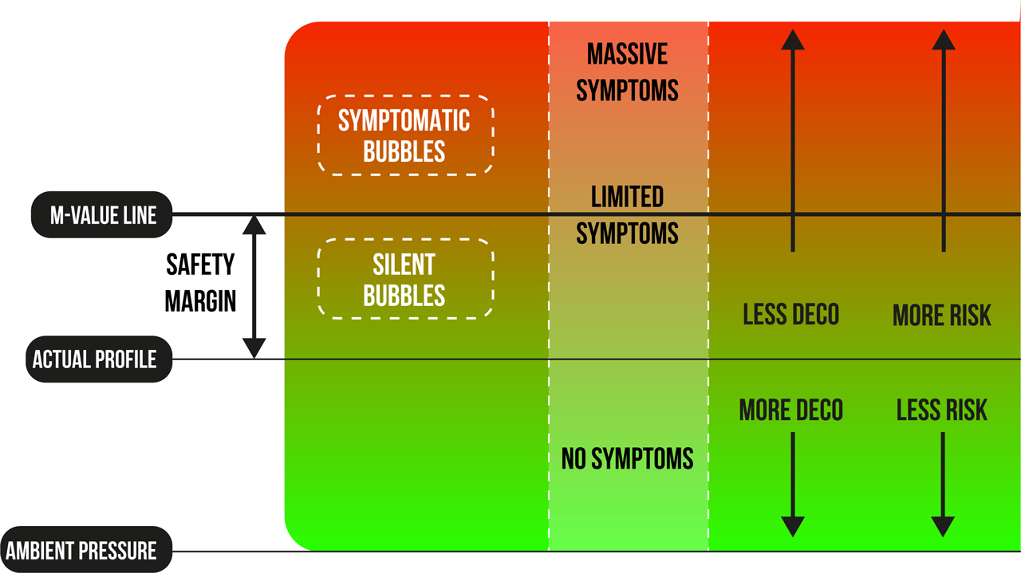
Background: Hyperbaric Environments
4. The M-Value
5. Example Decompression Model
4. https://www.tdisdi.com/wp-content/uploads/2022/08/M_Value_Graph-1.jpg
5. https://en.wikipedia.org/wiki/File:Inert_gas_tensions_in_the_tissue_compartments_during_a_decompression_dive.png

Slide 10
Implementation

Slide 11
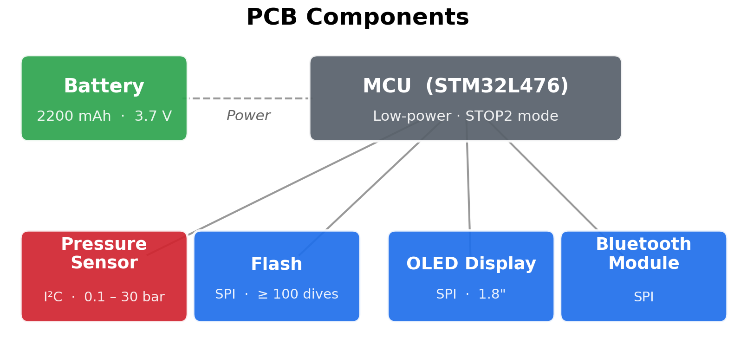
Implementation: Hardware

Slide 12
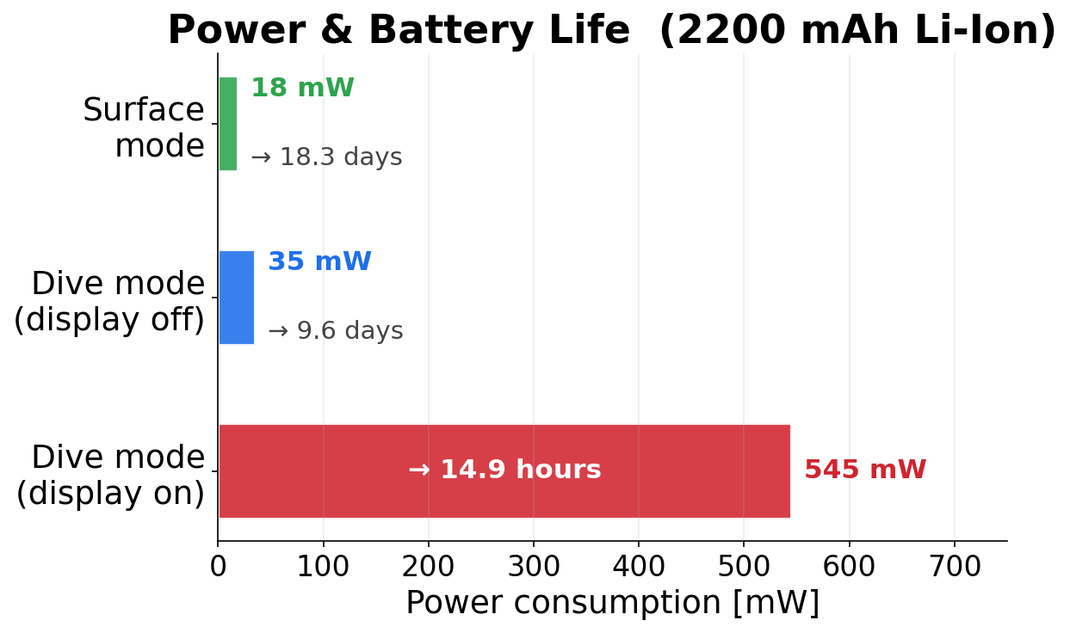
Implementation: Hardware

Slide 13
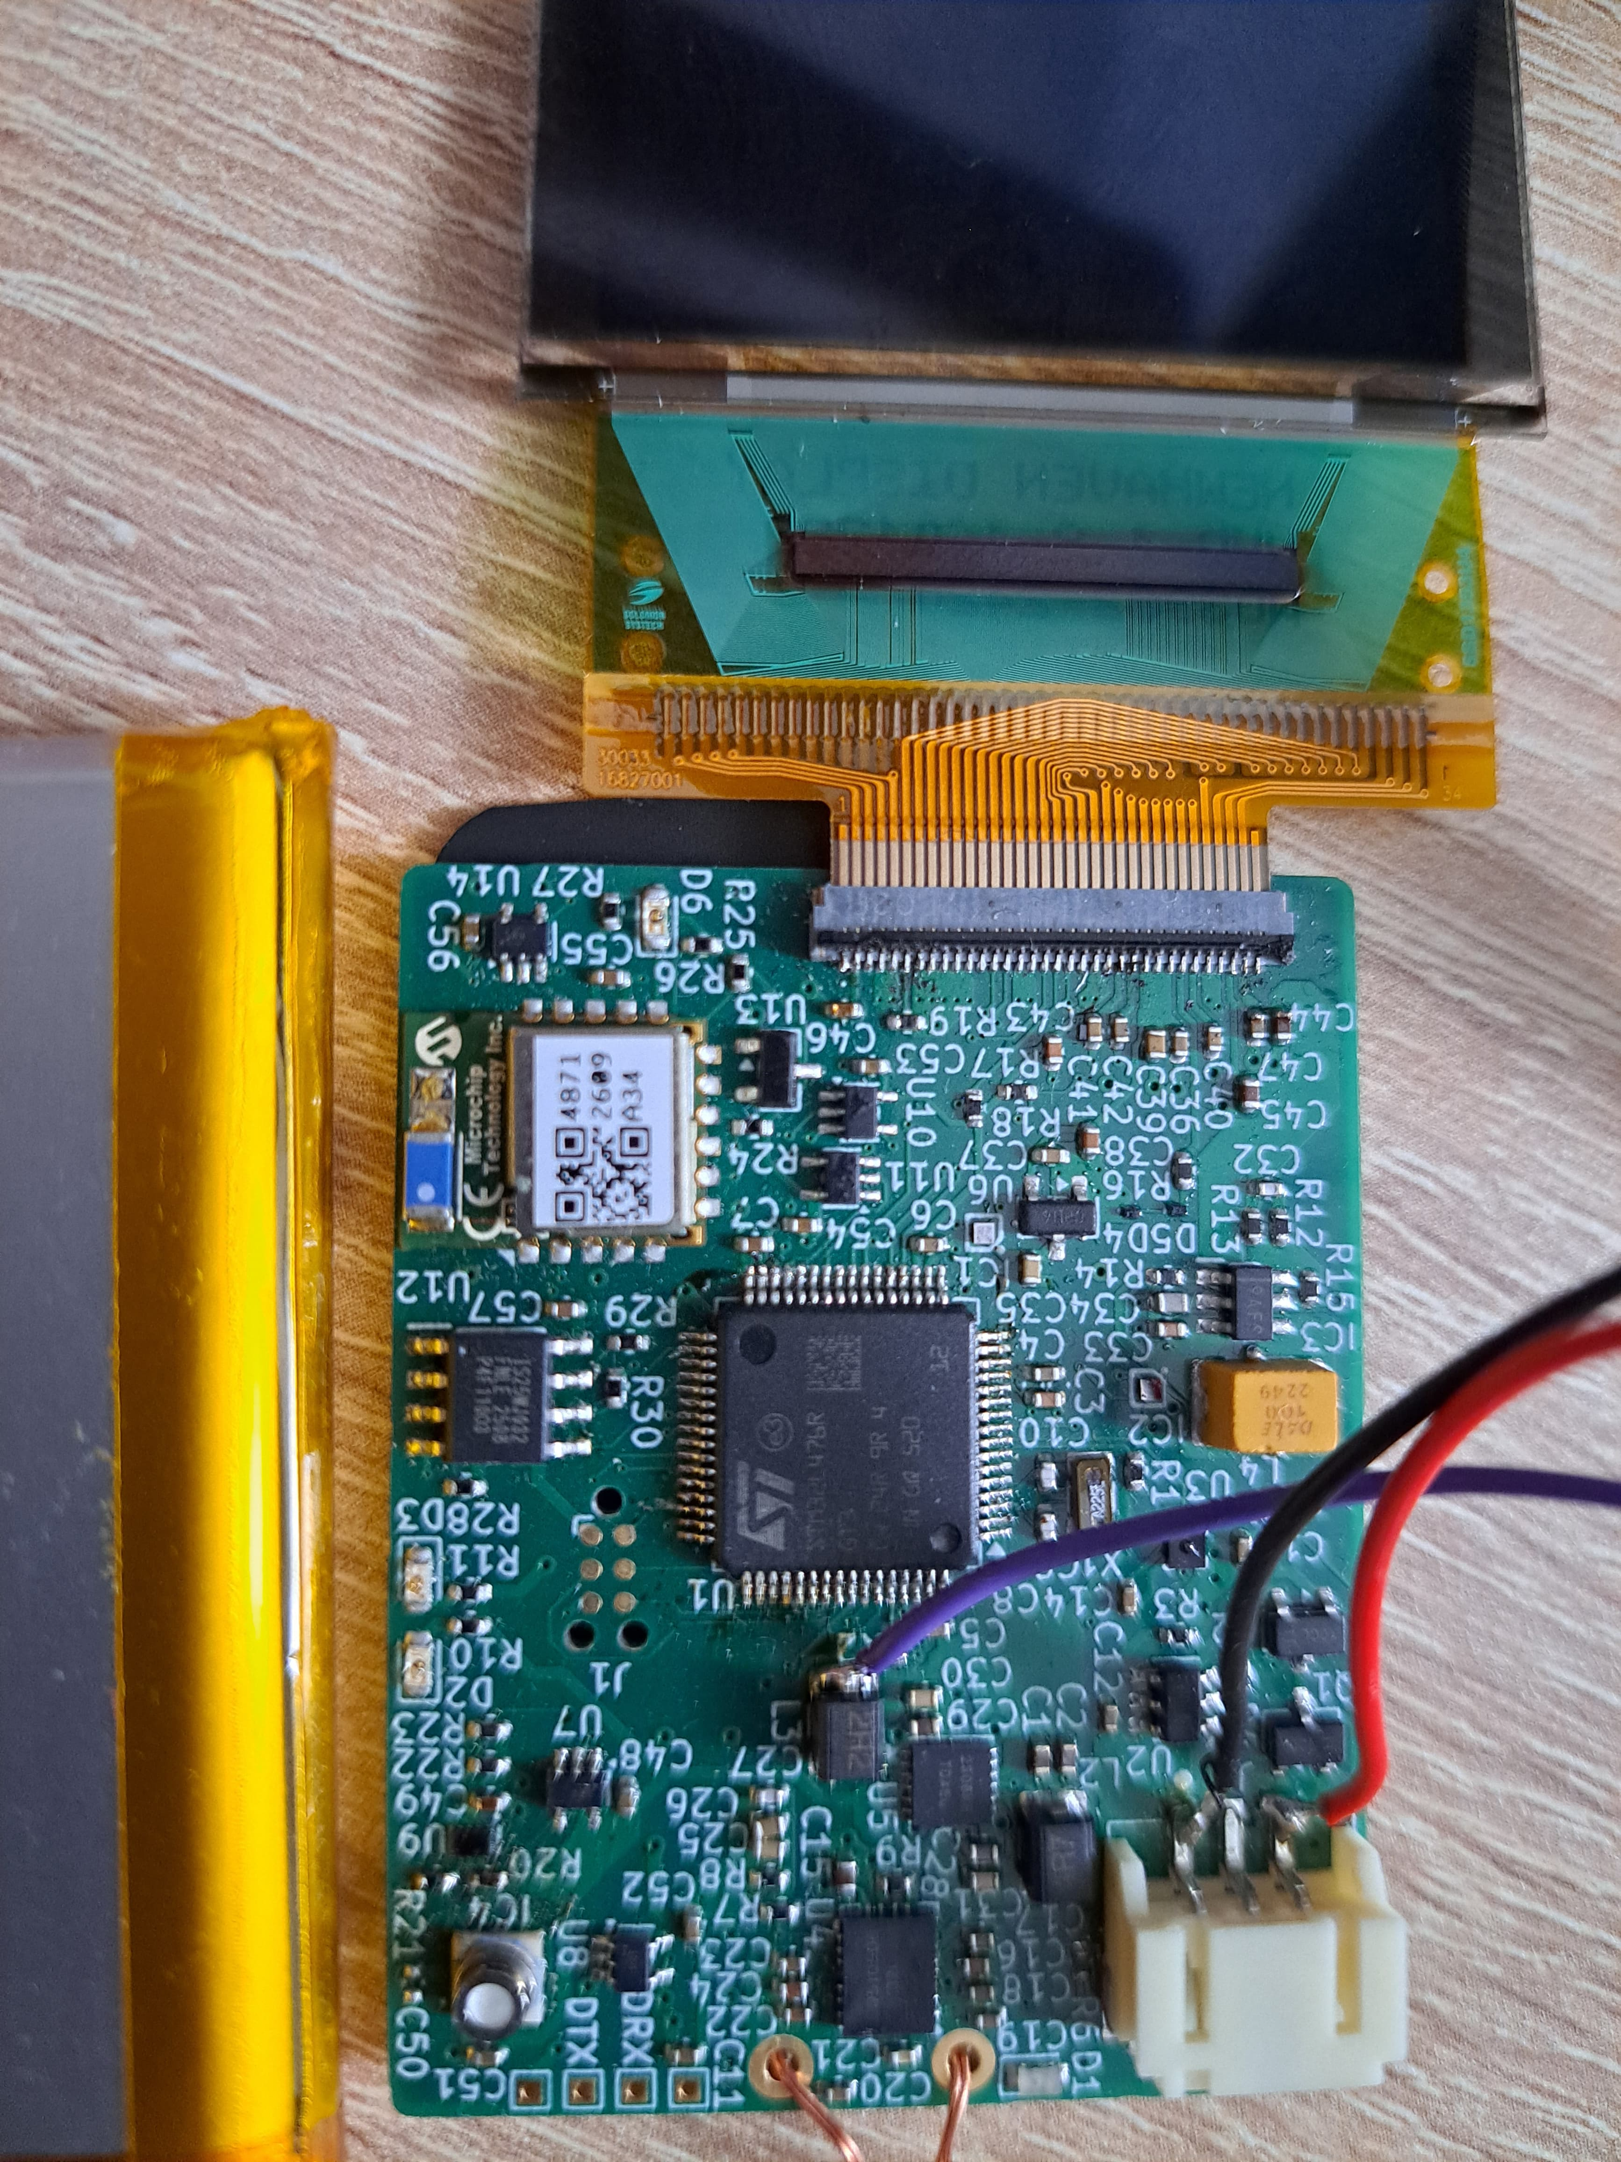
Implementation: Hardware
MCU: Low-Power
Battery: 18 days / 15 dive hours
Pressure sensor: 0.1-30 bar
External Bluetooth module
Large, bright, OLED display
Flash for >100 dives
Display
BLE
MCU
Flash
Pressure Sensor
Battery & Charging
Notes:
1MB Flash is enough for 600 dives @ 5s log rate

Slide 14
Implementation: Hardware - Components
MCU: STM32L476
Connector for 3.7V Li-ion battery (2200mAh)
  Wireless charging, battery protection
MS5849-30BA pressure sensor
RN-4871 BLE module
1.8’’ NHD OLED-Display
4MB Flash
Display
BLE
MCU
Flash
Pressure Sensor
Battery & Charging
Notes:
3.3V vs 1.8V rail

Slide 15
Implementation: Hardware – Power Distribution
1.8V
MCU
Flash
3.3V
Pressure Sensor
BLE Module
Display I/O
17V
Display V_{CC}
2.5V
Display VCI
LEDs
Display
BLE
MCU
Flash
Pressure Sensor
Battery & Charging
Notes:
1MB Flash is enough for 600 dives @ 5s log rate

Slide 16
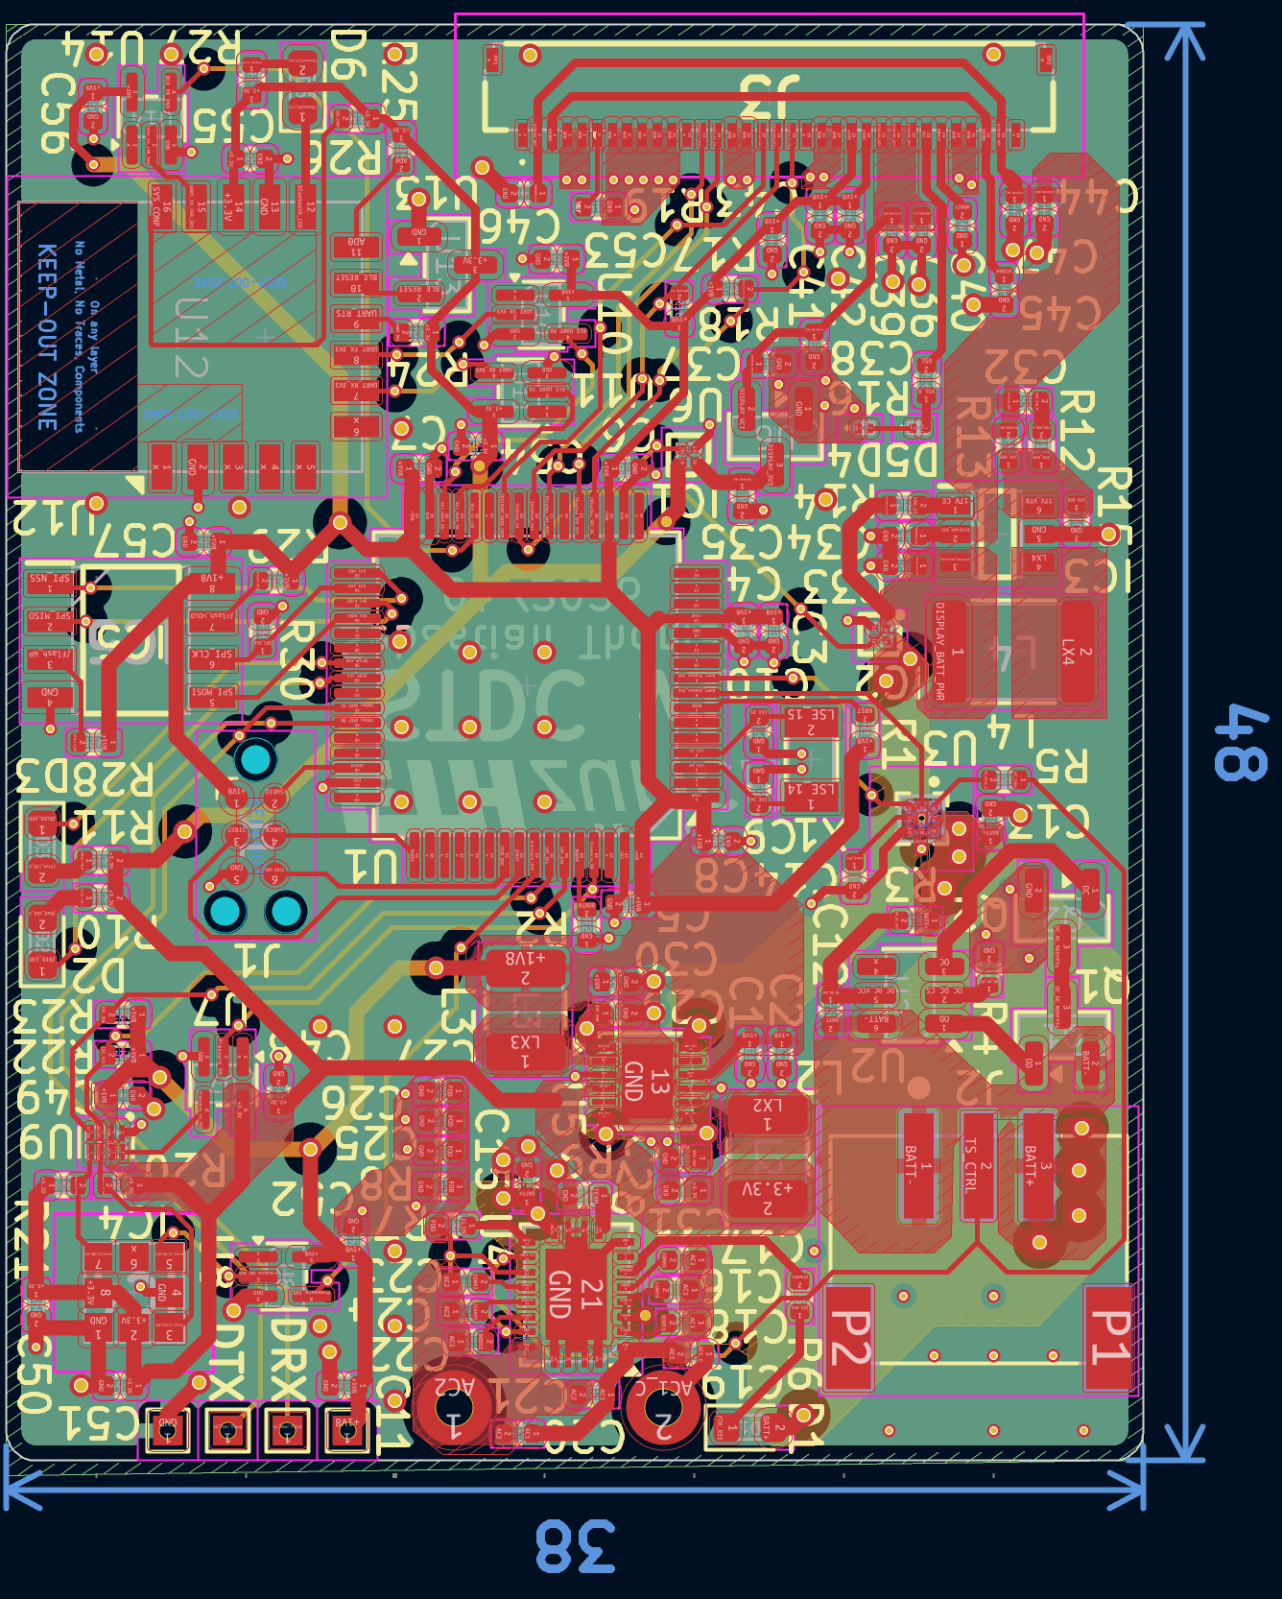
Implementation: PCB Layout
Display
BLE
MCU
Flash
Pressure Sensor
Battery & Charging
Notes:
1MB Flash is enough for 600 dives @ 5s log rate

Slide 17
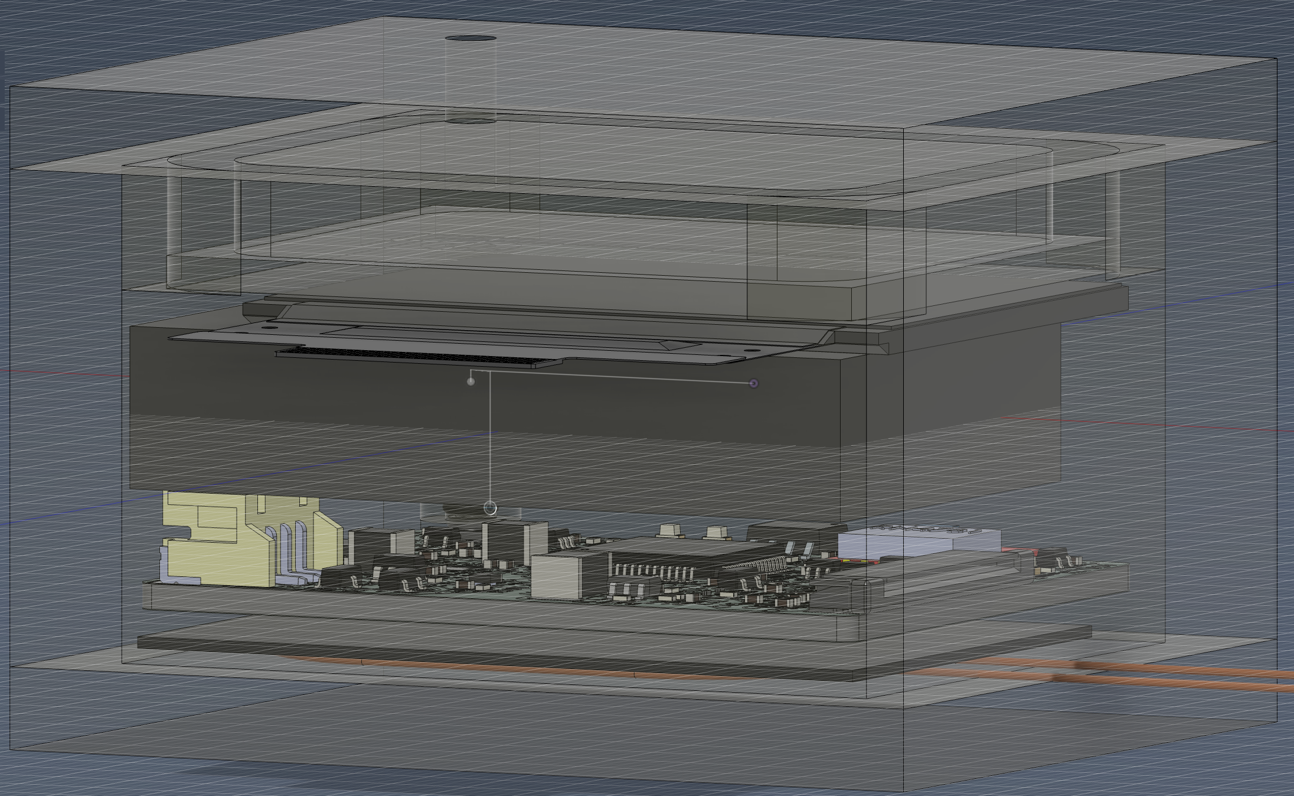
Example: Acrylic Enclosure

Slide 18
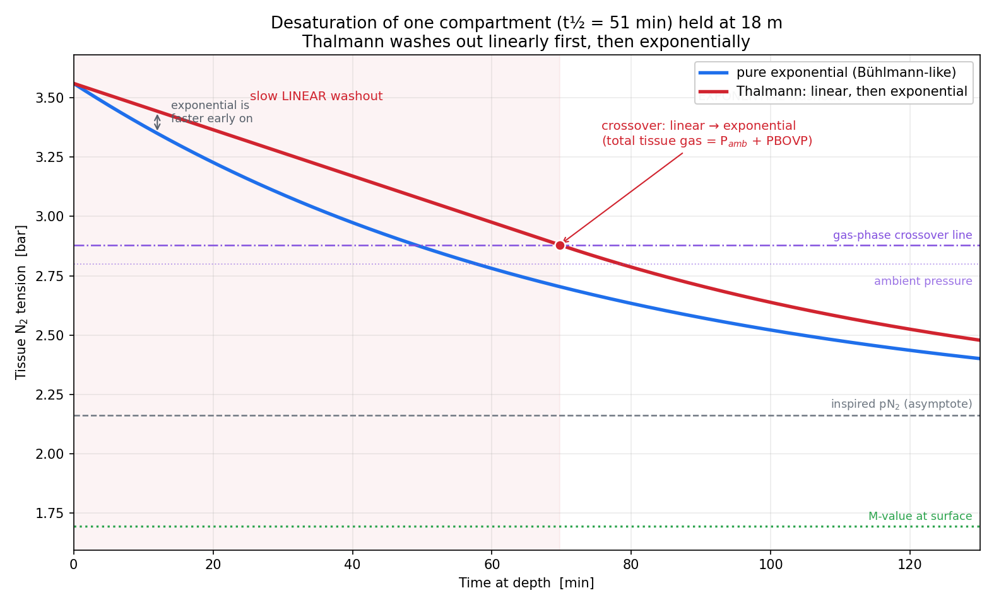
Implementation: Linear-Exponential decompression algorithm

Slide 19
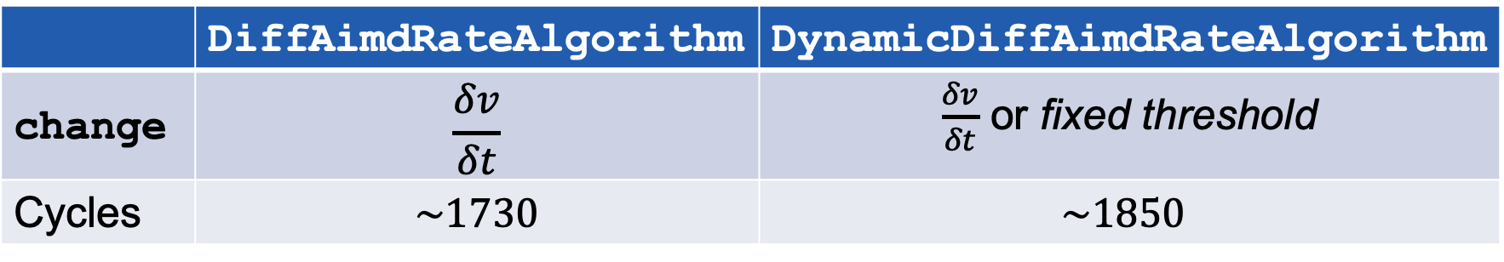
Implementation: Variable-rate algorithms
Additive Increase (AI), Multiplicative Decrease (MD – change)
 | DiffAimdRateAlgorithm | DynamicDiffAimdRateAlgorithm
change | $$\frac{δv}{δt}$$ | $\frac{δv}{δt}$ or fixed threshold
Cycles | $$\sim 1730$$ | $$\sim 1850$$
Notes:
Time Between Executions
Two distinct strategies

Slide 20
Results & Discussion

Slide 21
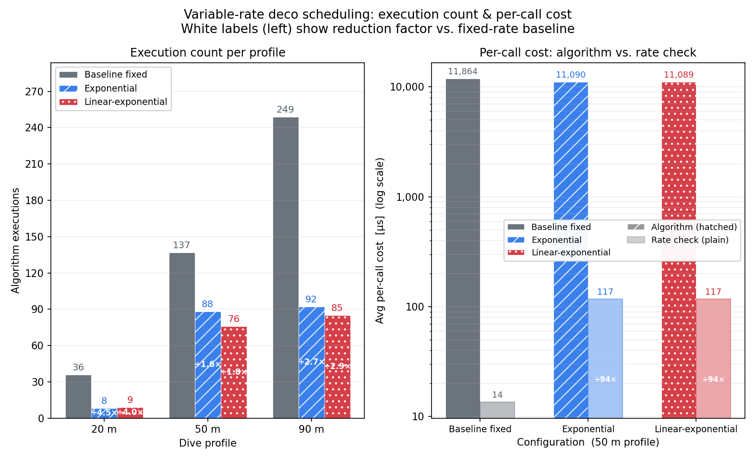
Results: Variable-rate algorithms – decompression models
Notes:
Explain plot work before analyzing
Trend line for saved
→ LOG Plot

Slide 22
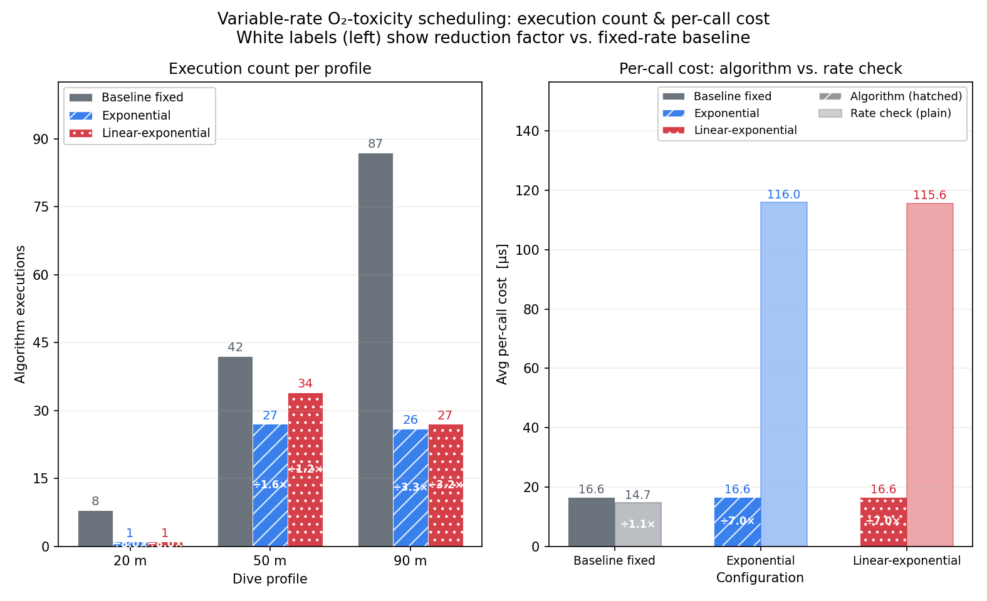
Results: Variable-rate algorithms – O2Tox calculation

Slide 23
Discussion: Variable-rate for diving algorithms
Variable-rate Decompression Model
$1/3×$ energy required
1/3× energy required
minor/short-term deviations
Variable-rate O2Tox
overhead too large

Slide 24
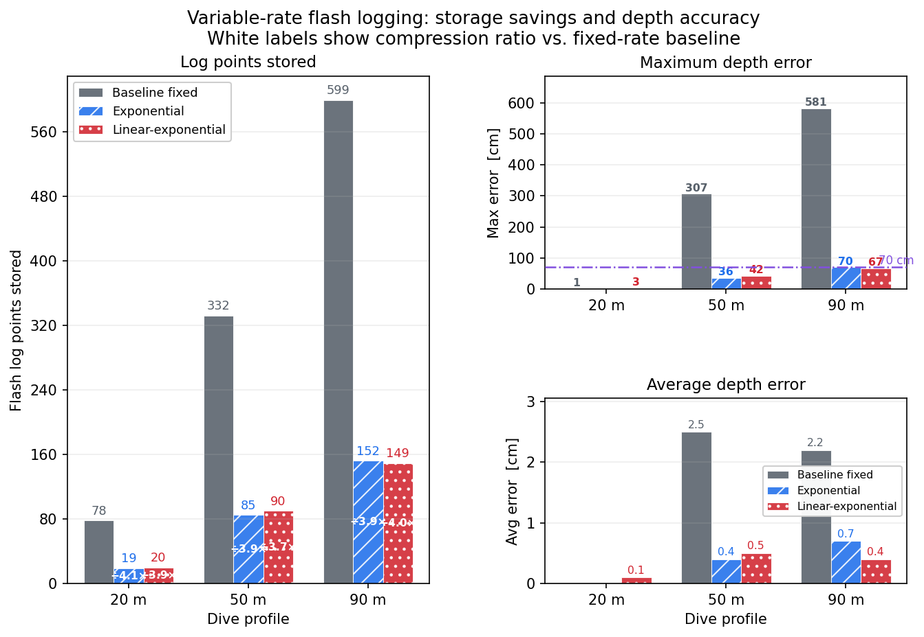
Results: Variable-rate algorithms – Dive Log to Flash

Slide 25
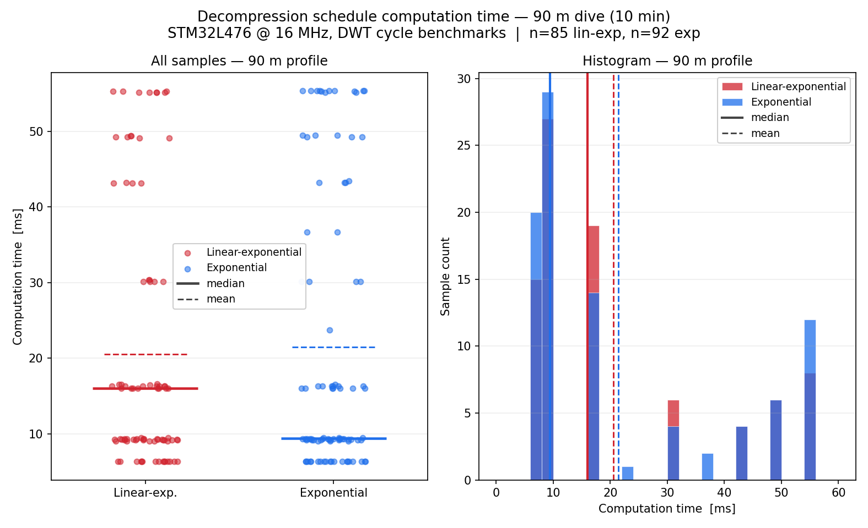
Results: Linear-exponential decompression algorithm

Slide 26

Discussion: Linear-exponential algorithms & Variable-rate Flash logging
Linear-exponential decompression algorithm
  As expected, customizability
Variable-rate Dive Log to Flash
  Space Reduction: $3.6×$-$4.1×$
Notes:
Feasible, performs as expected
Choice/customizability for users

Slide 27
Conclusion
Wearable, Compact, Open Source hardware
Linear-exponential Deco:
$≤ 20\%$ overhead
Linear-exponential Deco:
≤ 20% overhead
Variable-rate:
$≤0.28×$ flash space
$≤ 0.32×$ deco energy
Variable-rate:
≤0.28× flash space
≤ 0.32× deco energy
Notes:
Wearable, display
Concrete results and what was achieved
Flash Space saved and execution time decrease

Slide 28
Future Work
Real-world testing
Optimize algorithms
Fix hardware problems

Slide 29
Sebastian Thomas
Bachelor Thesis
tsebastian@student.ethz.ch
ETH Zürich
Center for Project-Based Learning
ETF F109
Sternwartstrasse 7
8092 Zürich
www.pbl.ee.ethz.ch

